Slide 1
Introduction to SQL
By: Iwan Herdian

Slide 2
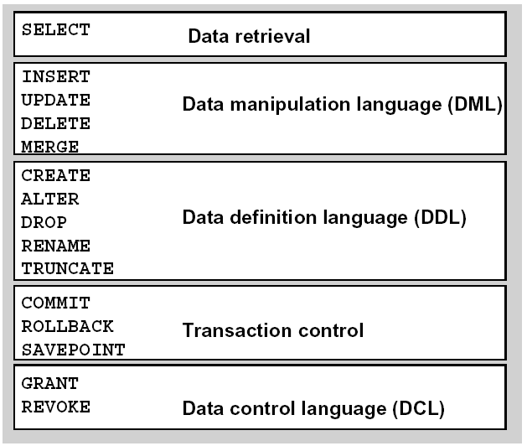
SQL Statement
The above reflects Oracle’s current development plans which are subject to change at any time
Notes:
Perintah-perintah pada SQL dibagi atas beberapa fungsionalitas:
Data Retrieval → Untuk mengambil data dari tabel-tabel
Data Manipulation Languange → Untuk mengubaha isi tabel
Data Definition Languange →Untuk Membuat,mengubah, atau menghapus struktur tabel
Transaction Control → Berkaitan dengan transaksi
Save Point berfungsi sebagai marker (penanda) untuk rollback
5.Data Control Languange → Berkaitan dengan management data

Slide 3
Data Retrieval
( SELECT Statement )
The above reflects Oracle’s current development plans which are subject to change at any time

Slide 4
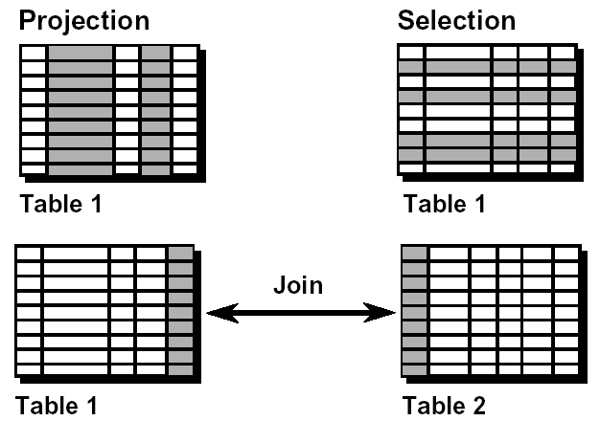
Capability SQL Statement
The above reflects Oracle’s current development plans which are subject to change at any time
Notes:
Denang perintah select, bisa melakukan:
Projection : Mengambil data pada kolom tertentu
Selection : Mengambil data pada baris tertentu
Join : Mengambil data dengan menggabungkan beberapa tabel

Slide 5

Basic SQL Statement
Select identifies what column
From identifies what table
The above reflects Oracle’s current development plans which are subject to change at any time

Slide 6
Writing SQL Statements
SQL statements are not case sensitive.
SQL statements can be on one or more lines.
Keywords cannot be abbreviated or split
across lines.
Clauses are usually placed on separate lines.
The above reflects Oracle’s current development plans which are subject to change at any time
Notes:
Boleh menggunakan huruf besar atau huruf kecil
Bisa terdiri dari beberapa baris (lebih dari 1 baris)
Keyword pada sql tidak bisa disiongkat atau dipisahkan pada beberapa line (misal:

Slide 7


Defining a Column Alias
A column alias:
Renames a column heading
Is useful with calculations
Immediately follows the column name - there can also be the optional AS keyword between the column name and alias
Requires double quotation marks if it contains
spaces or special characters or is case sensitive
The above reflects Oracle’s current development plans which are subject to change at any time
Notes:
SELECT ename nama
, ename AS name
, ename "nama depan"
, ename AS "first name"
, 12*(sal+100) ann_sal
FROM emp

Slide 8

Eliminating Duplicate Rows
The default display of queries is all rows, including duplicate rows
Eliminate duplicate rows by using the DISTINCT keyword in the SELECT clause.
The above reflects Oracle’s current development plans which are subject to change at any time

Slide 9
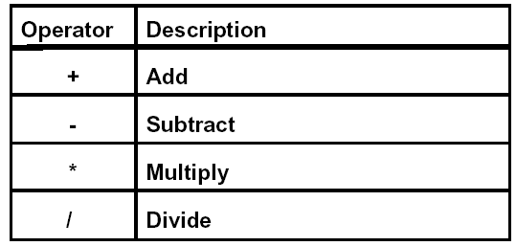
Arithmetic Expressions
Create expressions with number and date data by using arithmetic operators.
The above reflects Oracle’s current development plans which are subject to change at any time

Slide 10
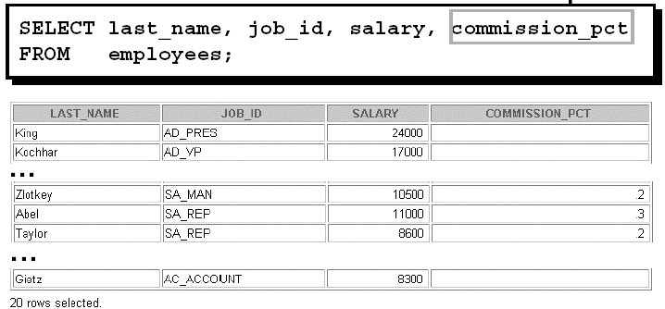
Defining a Null Value
A null is a value that is unavailable, unassigned, unknown, or inapplicable.
A null is not the same as zero or a blank space.
The above reflects Oracle’s current development plans which are subject to change at any time

Slide 11
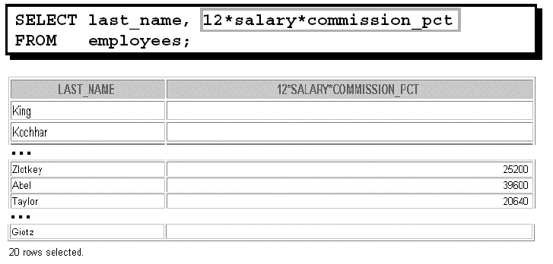
Null Values in Arithmetic Expressions
Arithmetic expressions containing a null value evaluate to null
The above reflects Oracle’s current development plans which are subject to change at any time

Slide 12
NVL Function
Converts a null to an actual value.
Data types that can be used are date, character, and number.
Data types must match:
-NVL(commission_pct,0)
-NVL(hire_date,’01-JAN-97’)
-NVL(job_id,’No Job Yet’)
The above reflects Oracle’s current development plans which are subject to change at any time

Slide 13

Concatenation Operator
A concatenation operator:
Concatenates columns or character strings to other columns
Is represented by two vertical bars (||)
Creates a resultant column that is a character expression
The above reflects Oracle’s current development plans which are subject to change at any time

Slide 14

Literal Character Strings
A literal is a character, a number, or a date
included in the SELECT list.
Date and character literal values must be enclosed within single quotation marks.
Each character string is output once for each row returned.
The above reflects Oracle’s current development plans which are subject to change at any time

Slide 15
Displaying Table Structure
The above reflects Oracle’s current development plans which are subject to change at any time

Slide 16

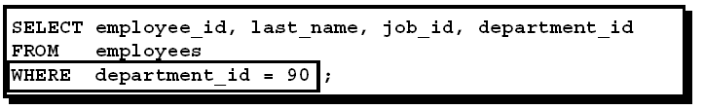
Limiting the Rows Selected
Restrict the rows returned by using the WHERE clause.
The WHERE clause follows the FROM clause.
The above reflects Oracle’s current development plans which are subject to change at any time

Slide 17

Character Strings and Dates
Character strings and date values are enclosed in single quotation marks.
Character values are case sensitive, and date values are format sensitive.
The default date format is DD-MON-RRRR.
The above reflects Oracle’s current development plans which are subject to change at any time

Slide 18
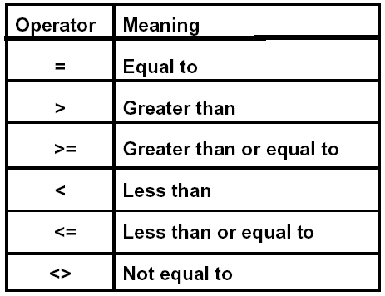
Comparison Conditions
The above reflects Oracle’s current development plans which are subject to change at any time

Slide 19
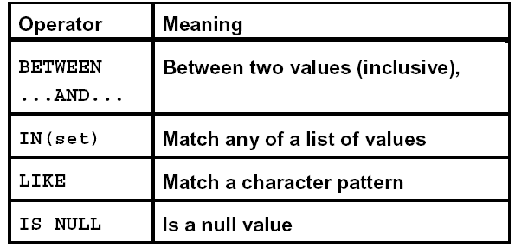
Other Comparison Conditions
The above reflects Oracle’s current development plans which are subject to change at any time

Slide 20
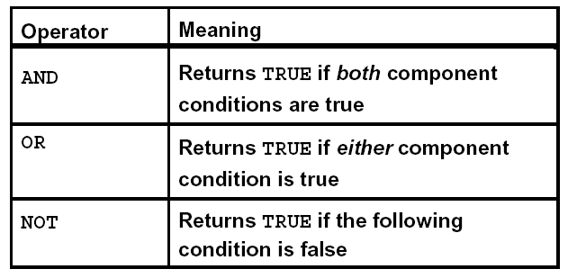
Logical Conditions
The above reflects Oracle’s current development plans which are subject to change at any time

Slide 21
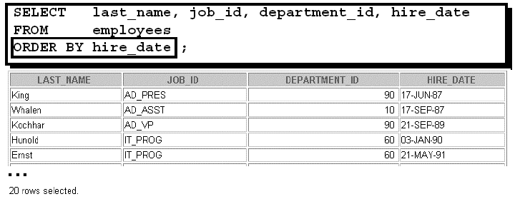
ORDER BY Clause
Sort rows with the ORDER BY clause
-ASC: ascending order, default
-DESC: descending order
The ORDER BY clause comes last in the SELECT statement.
The above reflects Oracle’s current development plans which are subject to change at any time

Slide 22
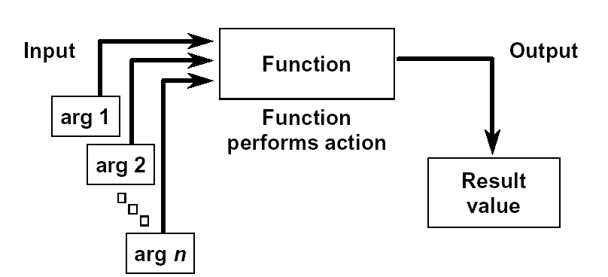
SQL Functions
The above reflects Oracle’s current development plans which are subject to change at any time

Slide 23
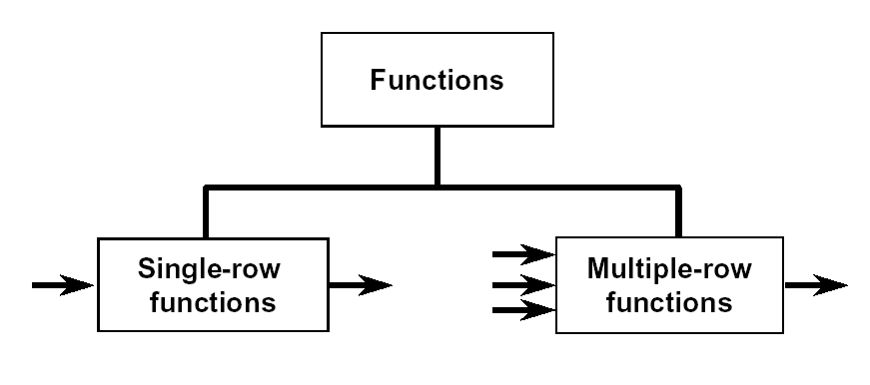
Two Types of SQL Functions
The above reflects Oracle’s current development plans which are subject to change at any time

Slide 24
Single-Row Functions
Single row functions:
Manipulate data items
Accept arguments and return one value
Act on each row returned
Return one result per row
May modify the data type
Can be nested
Accept arguments which can be a column or an
expression
The above reflects Oracle’s current development plans which are subject to change at any time
Notes:
Contoh: upper,lower,to_char(data_type,format) dll
Untuk Memanipulasi data
Memiliki beberapa parameter dan outputnya adalah sebuah value
Otomatis fungsi berjalan di tiap baris yg diquery
Di setiap baris tetap menghasilkan 1 buah value
Ada beberapa fungsi yang bisa mengubah data_type
Bisa dipakai secara nested (fungsi di dalam fungsi)
Parameter yang dimasukkan berupa kolom atau expresi

Slide 25
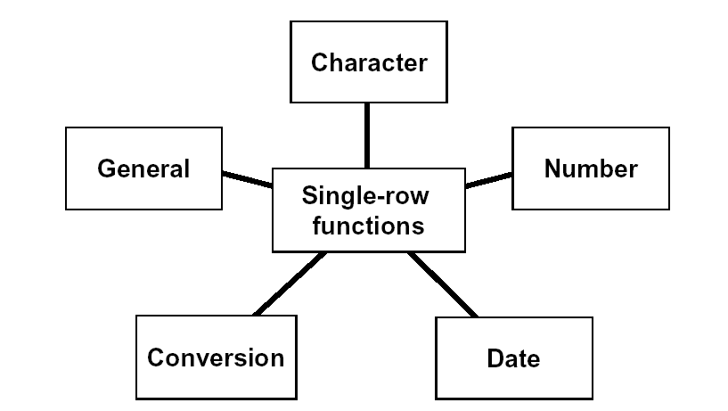
Single-Row Functions
The above reflects Oracle’s current development plans which are subject to change at any time

Slide 26
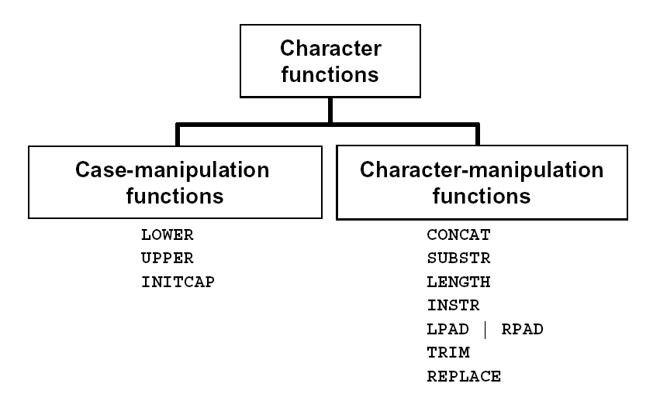
Character Functions
The above reflects Oracle’s current development plans which are subject to change at any time

Slide 27
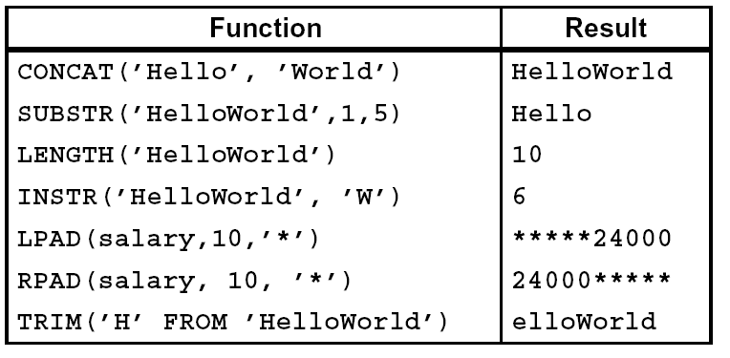
Character-Manipulation Functions
These functions manipulate character strings:
The above reflects Oracle’s current development plans which are subject to change at any time

Slide 28
Number Functions
ROUND: Rounds value to specified decimal
ROUND(45.926, 2) → 45.93
TRUNC: Truncates value to specified decimal
TRUNC(45.926, 2) → 45.92
MOD: Returns remainder of division
MOD(1600, 300) → 100
CEIL : Round value to maximum value
CEIL(4.1) → 5
Floor : Round value to minimum value
Floor(4.7) → 4
The above reflects Oracle’s current development plans which are subject to change at any time
Notes:
Round→ Pembulatan, sampai ditampilkan sesuai dengan parameter yang dimasukkan
Trunc→ Menuliskan

Slide 29
Number Functions
ABS : give output positive number, even negative number inputed
SIGN : return -1 for negative value, 1 for positive value
The above reflects Oracle’s current development plans which are subject to change at any time

Slide 30
Working with Dates
Oracle database stores dates in an internal
numeric format: century, year, month, day, hours,
minutes, seconds.
The default date display format is DD-MON-RR.
The above reflects Oracle’s current development plans which are subject to change at any time

Slide 31
Working with Dates
SYSDATE is a function that returns:
• Date
• Time
The above reflects Oracle’s current development plans which are subject to change at any time

Slide 32
Arithmetic with Dates
Add or subtract a number to or from a date for a resultant date value.
Subtract two dates to find the number of days between those dates.
Add hours to a date by dividing the number of hours by 24.
The above reflects Oracle’s current development plans which are subject to change at any time

Slide 33
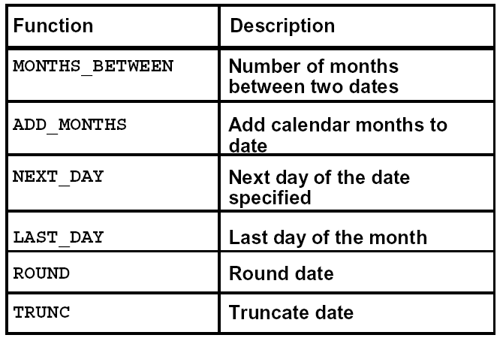
Date Functions
The above reflects Oracle’s current development plans which are subject to change at any time

Slide 34
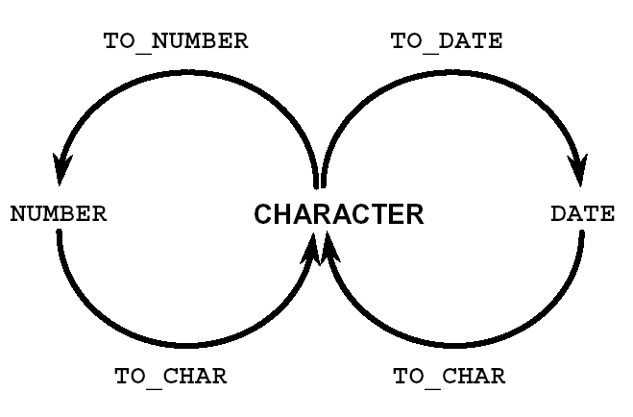
Explicit Data Type Conversion
The above reflects Oracle’s current development plans which are subject to change at any time

Slide 35
Using the TO_CHAR Function with Dates
The format model:
Must be enclosed in single quotation marks and is case sensitive
Can include any valid date format element
Has an fm element to remove padded blanks or suppress leading zeros
Is separated from the date value by a comma
The above reflects Oracle’s current development plans which are subject to change at any time

Slide 36
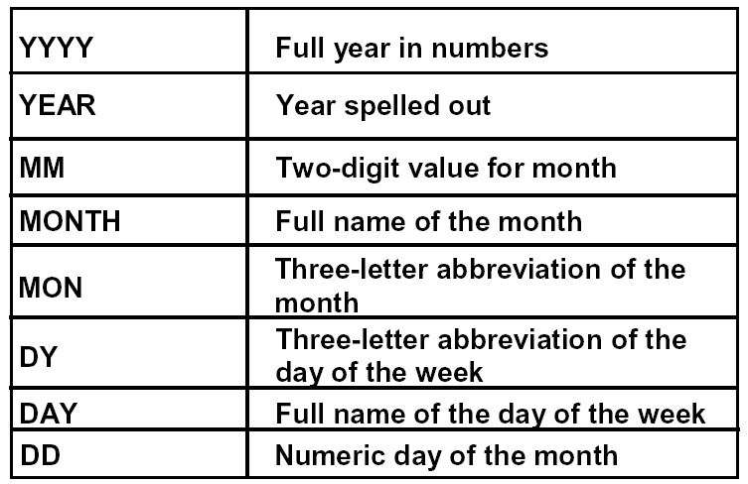
Elements of the Date Format Model
The above reflects Oracle’s current development plans which are subject to change at any time

Slide 37
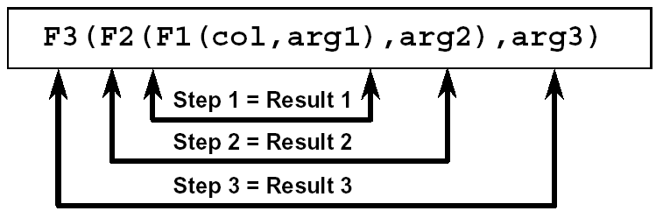
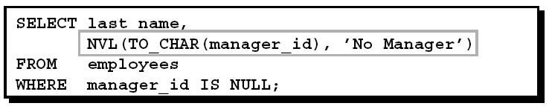
Nesting Functions
Single-row functions can be nested to any level.
Nested functions are evaluated from deepest level to the least deep level.
The above reflects Oracle’s current development plans which are subject to change at any time

Slide 38
NVL Function
Converts a null to an actual value.
Data types that can be used are date, character, and number.
Data types must match:
-NVL(commission_pct,0)
-NVL(hire_date,’01-JAN-97’)
-NVL(job_id,’No Job Yet’)
The above reflects Oracle’s current development plans which are subject to change at any time

Slide 39
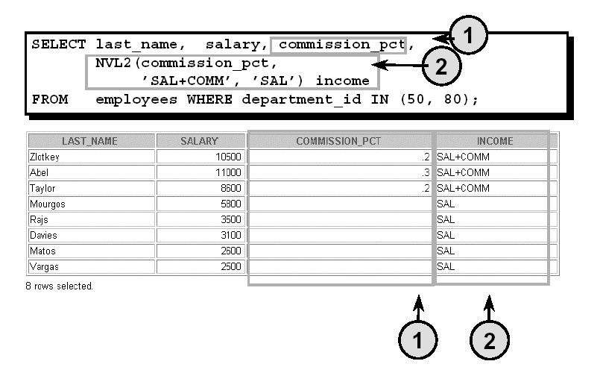
Using the NVL2 Function
The above reflects Oracle’s current development plans which are subject to change at any time

Slide 40
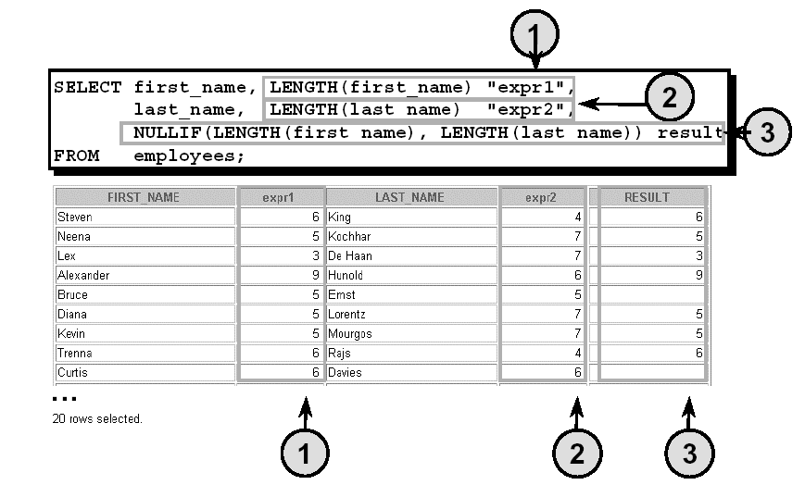
Using the NULLIF Function
The above reflects Oracle’s current development plans which are subject to change at any time

Slide 41
Conditional Expressions
Provide the use of IF-THEN-ELSE logic within a SQL statement
Use two methods:
-CASE expression
-DECODE function
The above reflects Oracle’s current development plans which are subject to change at any time

Slide 42
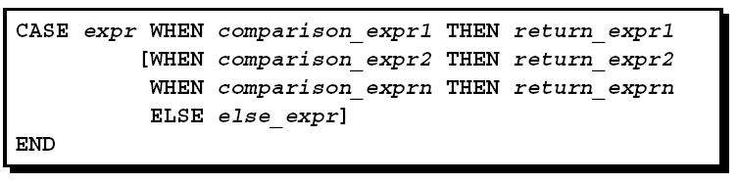
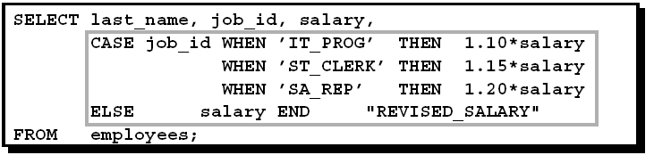
The CASE Expression
Facilitates conditional inquiries by doing the work of an IF-THEN-ELSE statement:
The above reflects Oracle’s current development plans which are subject to change at any time

Slide 43
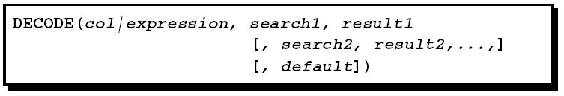
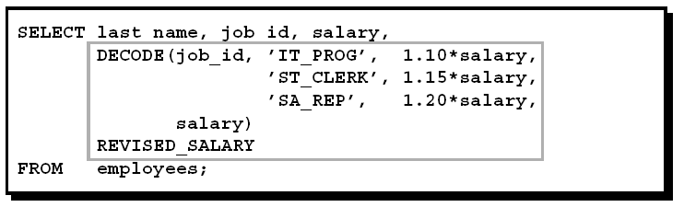
The DECODE Function
Facilitates conditional inquiries by doing the work of a CASE or IF-THEN-ELSE statement:
The above reflects Oracle’s current development plans which are subject to change at any time

Slide 44
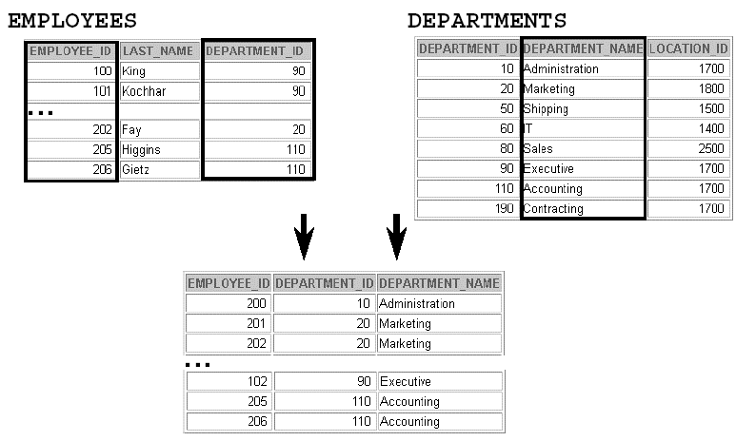
Obtaining Data from Multiple Tables
The above reflects Oracle’s current development plans which are subject to change at any time

Slide 45
Types of Joins
• Equijoin
• Non-equijoin
• Outer join
• Self join
The above reflects Oracle’s current development plans which are subject to change at any time

Slide 46

Joining Tables Using Oracle Syntax
Use a join to query data from more than one table.
Write the join condition in the WHERE clause.
Prefix the column name with the table name when the same column name appears in more than one table.
The above reflects Oracle’s current development plans which are subject to change at any time

Slide 47
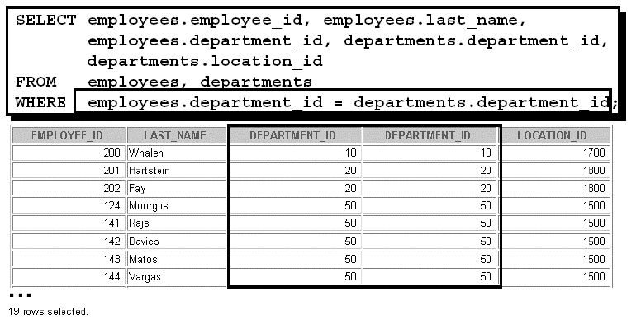
What is an Equijoin?
The above reflects Oracle’s current development plans which are subject to change at any time

Slide 48
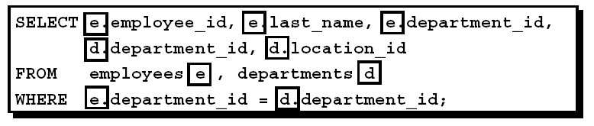
Using Table Aliases
Simplify queries by using table aliases.
Improve performance by using table prefixes.
The above reflects Oracle’s current development plans which are subject to change at any time

Slide 49
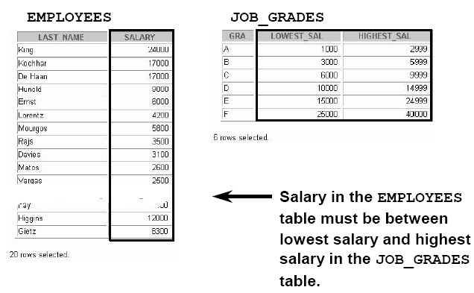
Non-Equijoins
The above reflects Oracle’s current development plans which are subject to change at any time

Slide 50
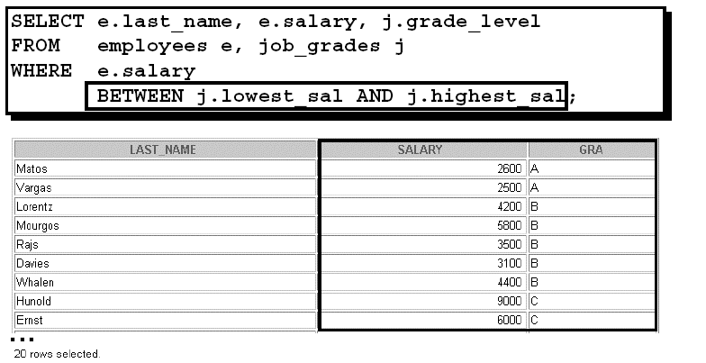
Non-Equijoins
The above reflects Oracle’s current development plans which are subject to change at any time

Slide 51
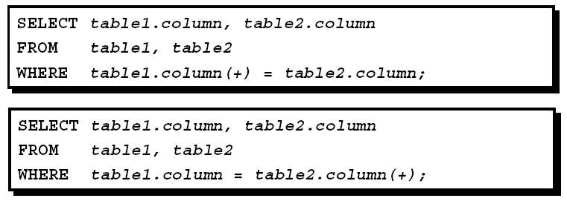
Outer Joins
You use an outer join to also see rows that do not meet the join condition
The Outer join operator is the plus sign (+)
The above reflects Oracle’s current development plans which are subject to change at any time

Slide 52
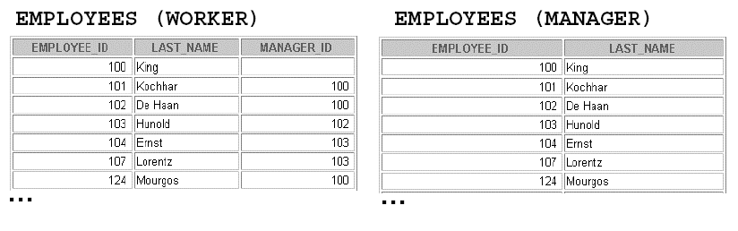
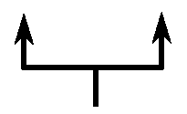
Self Joins
MANAGER_ID in the WORKER table is equal to EMPLOYEE_ID in the MANAGER table
The above reflects Oracle’s current development plans which are subject to change at any time

Slide 53
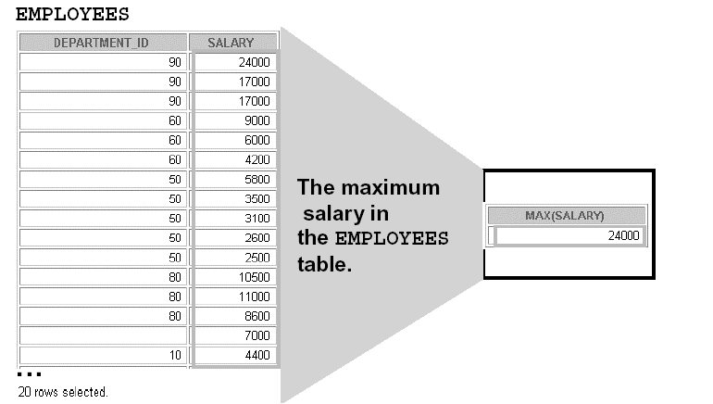
What Are Group Functions?
Group functions operate on sets of rows to give one result per group
The above reflects Oracle’s current development plans which are subject to change at any time

Slide 54
Types of Group Functions
AVG
COUNT
MAX
MIN
SUM
The above reflects Oracle’s current development plans which are subject to change at any time

Slide 55
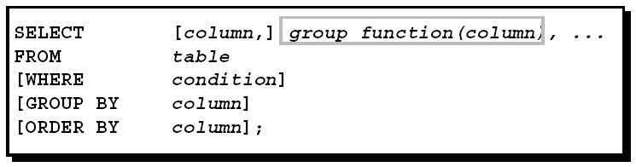
Group Functions Syntax
The above reflects Oracle’s current development plans which are subject to change at any time

Slide 56
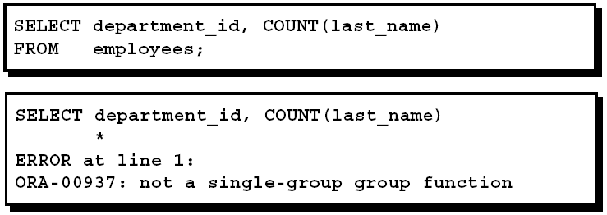
Illegal Queries Using Group Functions
Any column or expression in the SELECT list that is not an aggregate function must be in the GROUP BY clause.
The above reflects Oracle’s current development plans which are subject to change at any time

Slide 57
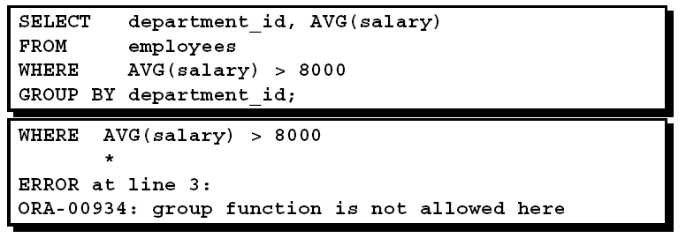
Illegal Queries
Using Group Functions
You cannot use the WHERE clause to restrict groups.
You use the HAVING clause to restrict groups.
You cannot use group functions in the WHERE clause
The above reflects Oracle’s current development plans which are subject to change at any time

Slide 58
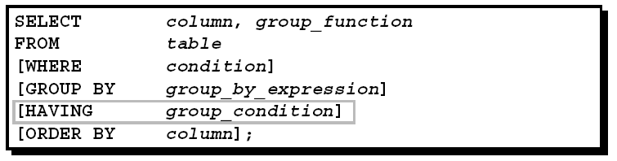

Excluding Group Results: The HAVING Clause
Use the HAVING clause to restrict groups:
1.Rows are grouped.
2.The group function is applied.
3.Groups matching the HAVING clause are displayed
The above reflects Oracle’s current development plans which are subject to change at any time

Slide 59

Subquery
The subquery (inner query) executes once before the main query.
The result of the subquery is used by the main query (outer query).
The above reflects Oracle’s current development plans which are subject to change at any time

Slide 60
Guidelines for Using Subqueries
Enclose subqueries in parentheses.
Place subqueries on the right side of the comparison condition.
The ORDER BY clause in the subquery is not needed unless you are performing Top-N analysis.
Use single-row operators with single-row subqueries and use multiple-row operators with
multiple-row subqueries.
The above reflects Oracle’s current development plans which are subject to change at any time

Slide 61
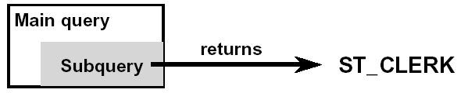
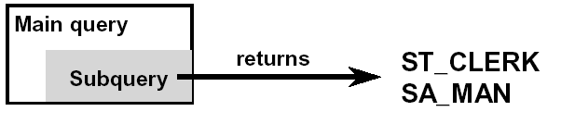
Types of Subqueries
Single-row subquery
Multiple-row subquery
The above reflects Oracle’s current development plans which are subject to change at any time

Slide 62
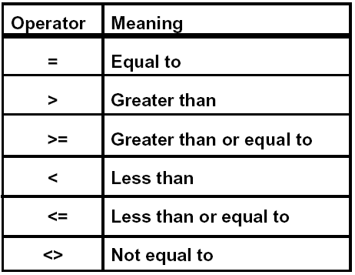
Single-Row Subqueries
Return only one row
Use single-row comparison operators
The above reflects Oracle’s current development plans which are subject to change at any time

Slide 63
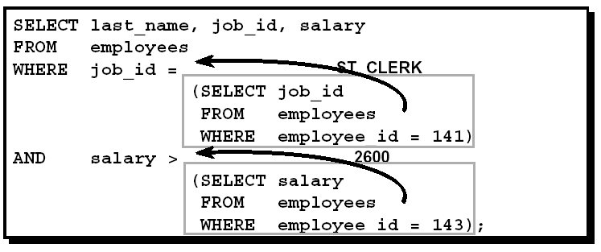

Example Single-Row Subqueries
The above reflects Oracle’s current development plans which are subject to change at any time

Slide 64
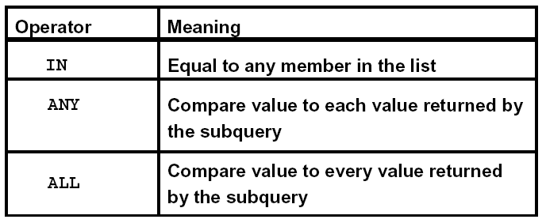
Multiple-Row Subqueries
Return more than one row
Use multiple-row comparison operators
The above reflects Oracle’s current development plans which are subject to change at any time

Slide 65
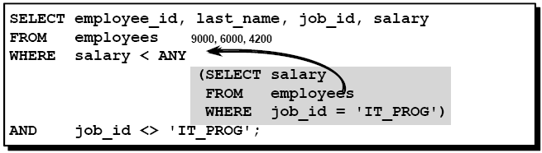
ANY Operator
<ANY means less than maximum
>ANY means more than minimum
=ANY equivalent to IN
The above reflects Oracle’s current development plans which are subject to change at any time

Slide 66
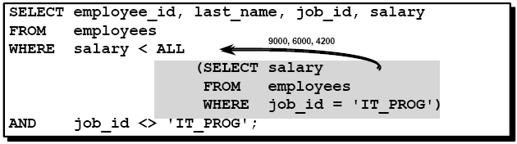
ALL Operator
<ALL means less than minimum
>ALL means more than maximum
The above reflects Oracle’s current development plans which are subject to change at any time

Slide 67
Data Manipulation Language
The above reflects Oracle’s current development plans which are subject to change at any time

Slide 68
Data Manipulation Language
A DML statement is executed when you:
-Add new rows to a table
-Modify existing rows in a table
-Remove existing rows from a table
A transaction consists of a collection of DML statements that form a logical unit of work.
The above reflects Oracle’s current development plans which are subject to change at any time

Slide 69
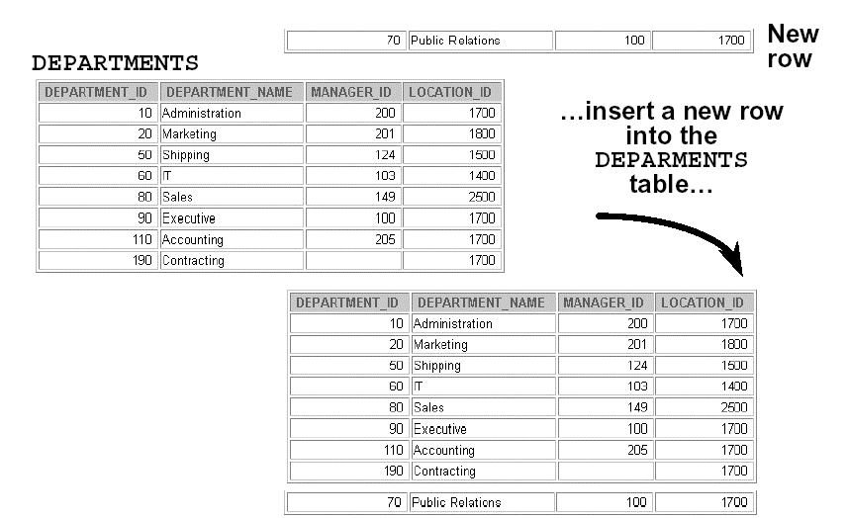
Adding a New Row to a Table
The above reflects Oracle’s current development plans which are subject to change at any time

Slide 70

The INSERT Statement Syntax
Add new rows to a table by using the INSERT statement
Only one row is inserted at a time with this syntax.
The above reflects Oracle’s current development plans which are subject to change at any time

Slide 71
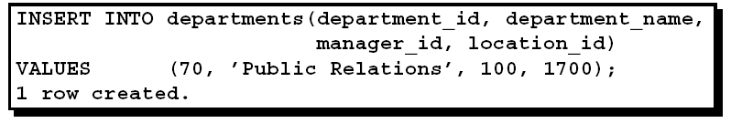
Inserting New Rows
Insert a new row containing values for each column.
List values in the default order of the columns in the table.
Optionally, list the columns in the INSERT clause.
Enclose character and date values within single quotation marks
The above reflects Oracle’s current development plans which are subject to change at any time

Slide 72


Inserting Rows with Null Values
Implicit method: Omit the column from the
column list.
Explicit method: Specify the NULL keyword in the VALUES clause
The above reflects Oracle’s current development plans which are subject to change at any time

Slide 73
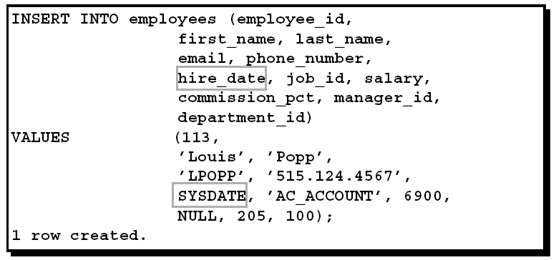
Inserting Special Values
The SYSDATE function records the current date and time.
The above reflects Oracle’s current development plans which are subject to change at any time

Slide 74
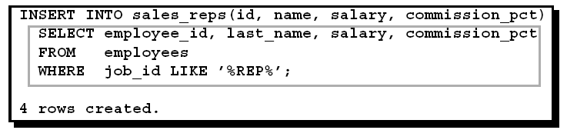
Copying Rows from Another Table
Write your INSERT statement with a subquery.
Do not use the VALUES clause.
Match the number of columns in the INSERT
clause to those in the subquery.
The above reflects Oracle’s current development plans which are subject to change at any time

Slide 75

The UPDATE Statement Syntax
Modify existing rows with the UPDATE statement.
Update more than one row at a time, if required.
The above reflects Oracle’s current development plans which are subject to change at any time

Slide 76


Updating Rows in a Table
Specific row or rows are modified if you specify the WHERE clause.
All rows in the table are modified if you omit the WHERE clause.
The above reflects Oracle’s current development plans which are subject to change at any time

Slide 77

The DELETE Statement
You can remove existing rows from a table by using the DELETE statement
The above reflects Oracle’s current development plans which are subject to change at any time

Slide 78


Deleting Rows from a Table
Specific rows are deleted if you specify the WHERE clause.
All rows in the table are deleted if you omit the WHERE clause.
The above reflects Oracle’s current development plans which are subject to change at any time

Slide 79

Using a Subquery in an INSERT Statement
The above reflects Oracle’s current development plans which are subject to change at any time

Slide 80

Using the WITH CHECK OPTION Keyword on DML Statements
A subquery is used to identify the table and columns of the DML statement.
The WITH CHECK OPTION keyword prohibits you from changing rows that are not in the subquery.
The above reflects Oracle’s current development plans which are subject to change at any time

Slide 81
Transaction Control
The above reflects Oracle’s current development plans which are subject to change at any time

Slide 82
Database Transactions
A database transaction consists of one of the following:
  DML statements which constitute one consistent change to the data
  One DDL statement
  One DCL statement
The above reflects Oracle’s current development plans which are subject to change at any time

Slide 83
Database Transactions
Begin when the first DML SQL statement is executed
End with one of the following events:
- A COMMIT or ROLLBACK statement is issued
- A DDL or DCL statement executes (automatic commit)
The above reflects Oracle’s current development plans which are subject to change at any time

Slide 84

Controlling Transactions
The above reflects Oracle’s current development plans which are subject to change at any time

Slide 85

Rolling Back Changes to a Marker
Create a marker in a current transaction by using the SAVEPOINT statement.
Roll back to that marker by using the ROLLBACK TO SAVEPOINT statement
The above reflects Oracle’s current development plans which are subject to change at any time

Slide 86
State of the Data
Before COMMIT or ROLLBACK
The previous state of the data can be recovered.
The current user can review the results of the DML operations by using the SELECT statement.
Other users cannot view the results of the DML
statements by the current user.
The affected rows are locked; other users cannot change the data within the affected rows.
The above reflects Oracle’s current development plans which are subject to change at any time

Slide 87
State of the Data after COMMIT
Data changes are made permanent in the database.
The previous state of the data is permanently lost.
All users can view the results.
Locks on the affected rows are released; those rows are available for other users to manipulate.
All savepoints are erased.
The above reflects Oracle’s current development plans which are subject to change at any time

Slide 88
State of the Data After ROLLBACK
Discard all pending changes by using the ROLLBACKstatement:
  Data changes are undone.
  Previous state of the data is restored.
  Locks on the affected rows are released.
The above reflects Oracle’s current development plans which are subject to change at any time

